Slide 1
DRIVE FOCUSED.
DRIVE SMART.
GET HOME SAFELY.

Slide 2
What Is Distracted Driving?
Distraction occurs when drivers divert their attention from the driving task to focus on some other activity.

Slide 3

What Is Distracted Driving?
Visual Distraction
Reading a text message, looking up directions, “rubber necking” (i.e., craning one’s neck to get a better view) at a crash site

Slide 4

What Is Distracted Driving?
Manual Distraction
Reaching for things inside the vehicle, using a hand-held device, adjusting the radio, eating or drinking, applying makeup

Slide 5

What Is Distracted Driving?
Cognitive Distraction
Talking on the phone, arguing with a passenger, thinking about your next appointment

Slide 6
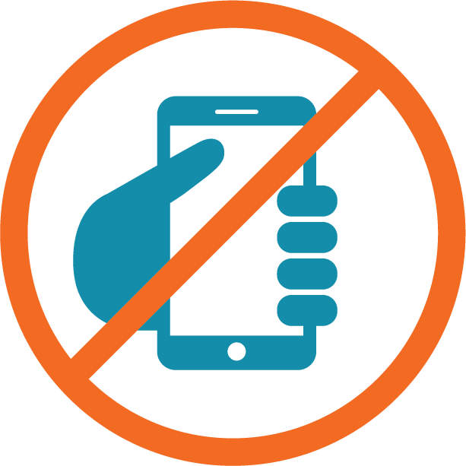

There is a Disconnect
Despite all the research indicating that any form of mobile phone use is unsafe while driving, in a large AAA survey of drivers:
2/3 say using a hand-held phone is unacceptable
2/3 say using a hands-free phone is acceptable

Slide 7
Cell Phones Are Distractions
Although there are many things that contribute to distracted driving, according to the National Safety Council, the use of cell phones occurs with such frequency and duration that it is more likely to lead to a crash or near-crash than other forms of distraction.

Slide 8
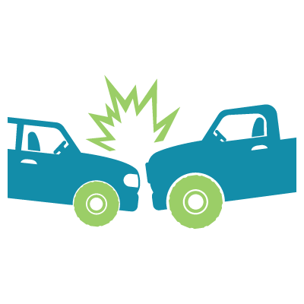
Cell Phones Are Distractions
In 2015:
3,477 people died in crashes involving distracted drivers
14% of these crashes were reported to have involved cell phone use as a distraction

Slide 9
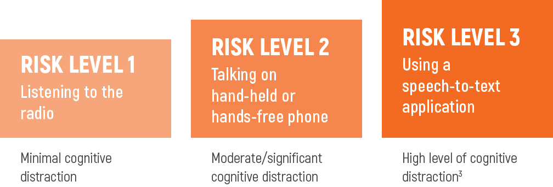
Distraction Risk Levels

Slide 10
7 Action Steps Against Distraction
1
Avoid Temptation
Don’t talk or text on your phone. Turn it off while driving or place your device in the glove box or center console so it’s out of sight and out of mind.

Slide 11
7 Action Steps Against Distraction
2
Vary Your Route
When possible, take a different route so routine trips like commuting to and from work don’t become mundane.

Slide 12
7 Action Steps Against Distraction
3
Keep Your Eyes Moving
Make a full mirror sweep with your eyes every 5-6 seconds to stay alert and ward off allowing your mind to wander.

Slide 13
7 Action Steps Against Distraction
4
Keep A Safe Following Distance
Driver training experts suggest a following distance of 3-4 seconds in good weather—more in inclement weather. The 3-4-second following rule increases visibility and gives more time to react to what’s happening in front of you, reducing risk to you and your passengers.

Slide 14
7 Action Steps Against Distraction
5
Clear Your Mind
You cannot focus on driving if your mind is on work or family pressure or your to-do list. Take a moment before you drive to get your mind focused on the task at hand—getting to your destination safely.

Slide 15
7 Action Steps Against Distraction
6
Have a Plan
Don’t wait until you are driving to plan and become familiar with your route. Use navigation devices with voice directions and set them prior to pulling out.

Slide 16
7 Action Steps Against Distraction
7
Help Others Help Themselves
Make it a practice when you call someone’s cell phone to ask if they are driving. If the answer is “yes,” take it upon yourself to call back later or ask them to return your call when they’ve reached their destination. And never text someone you know to be driving.

Slide 17
Let it begin with you.
DRIVE FOCUSED.
DRIVE SMART.
GET HOME SAFELY.
www.trafficsafety.org

